Slide 1
Portland Cyber Theatre

Slide 2
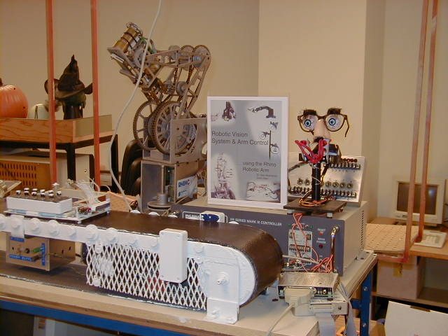
2000
Portland

Slide 3
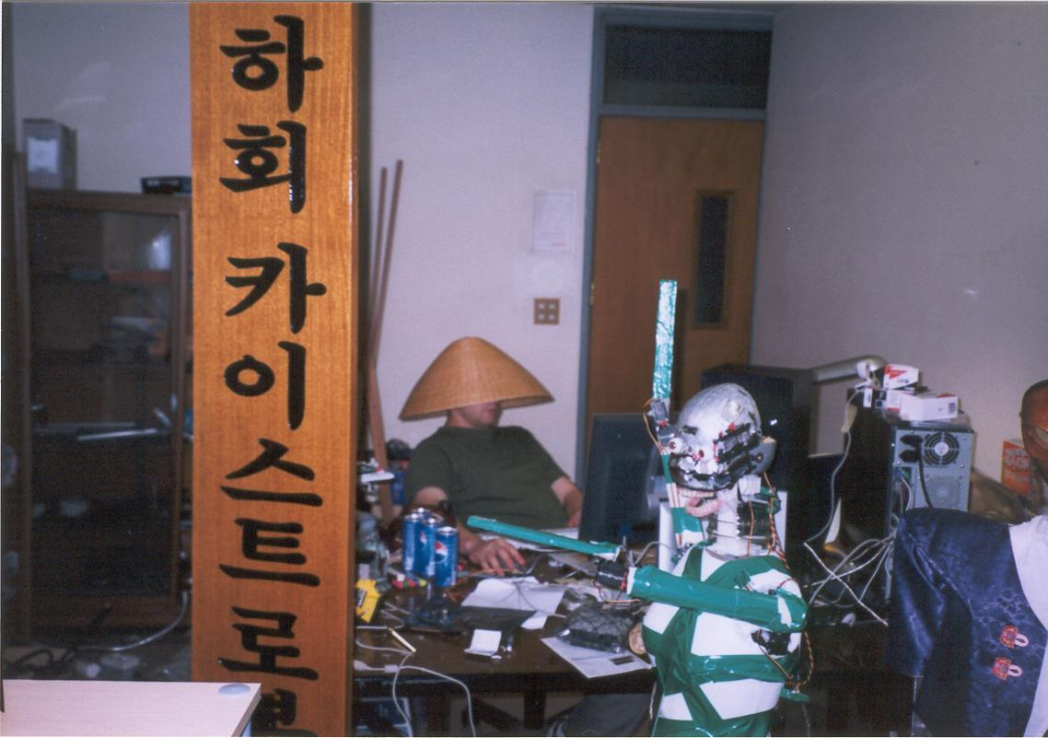
Korea
2004

Slide 4
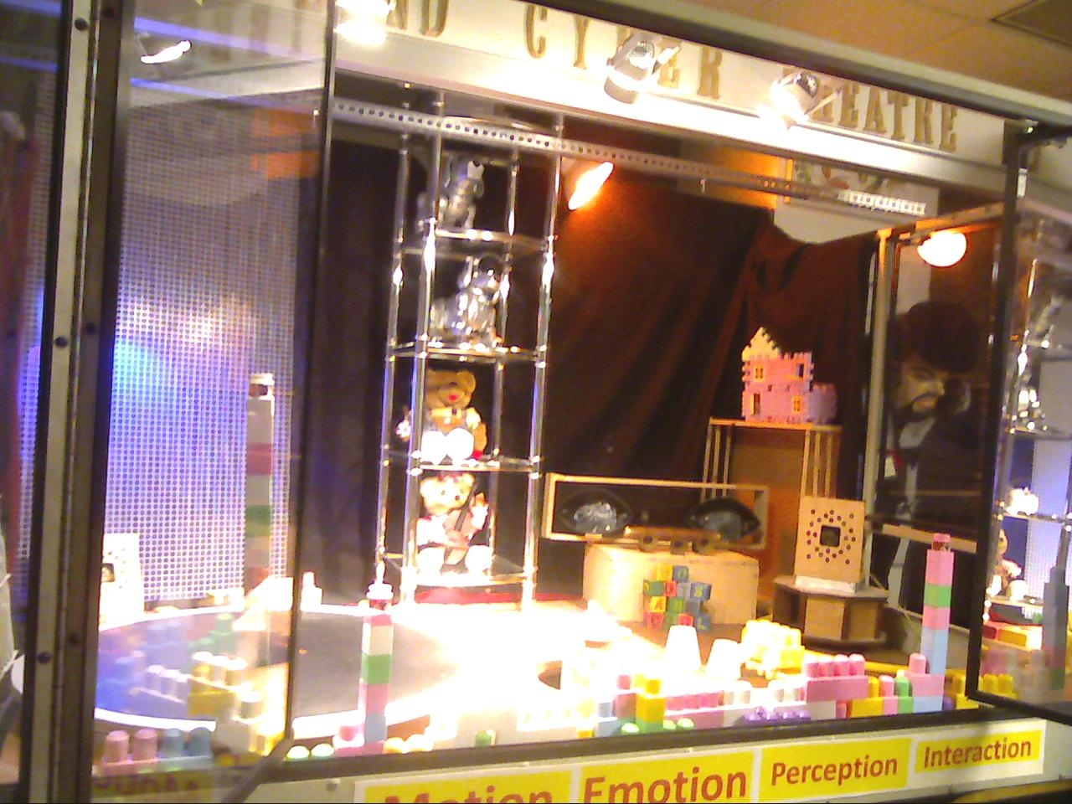
2010
2010
Portland

Slide 5
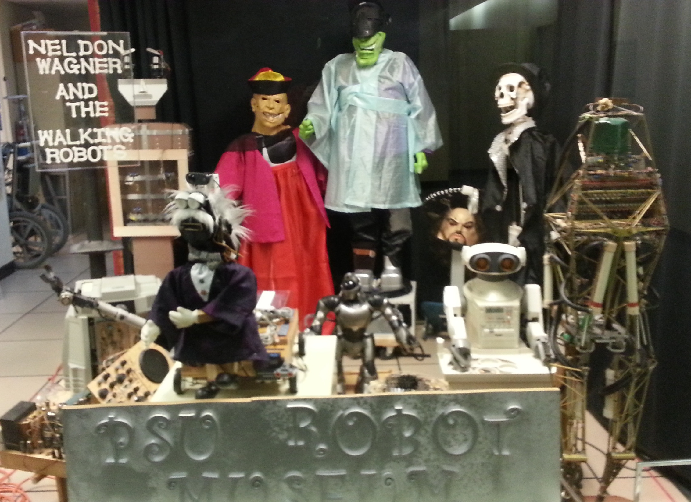
2012
Portland

Slide 6
The Hahoe Pylyishin Play

Slide 7
Korea - thirteen Century

Slide 8
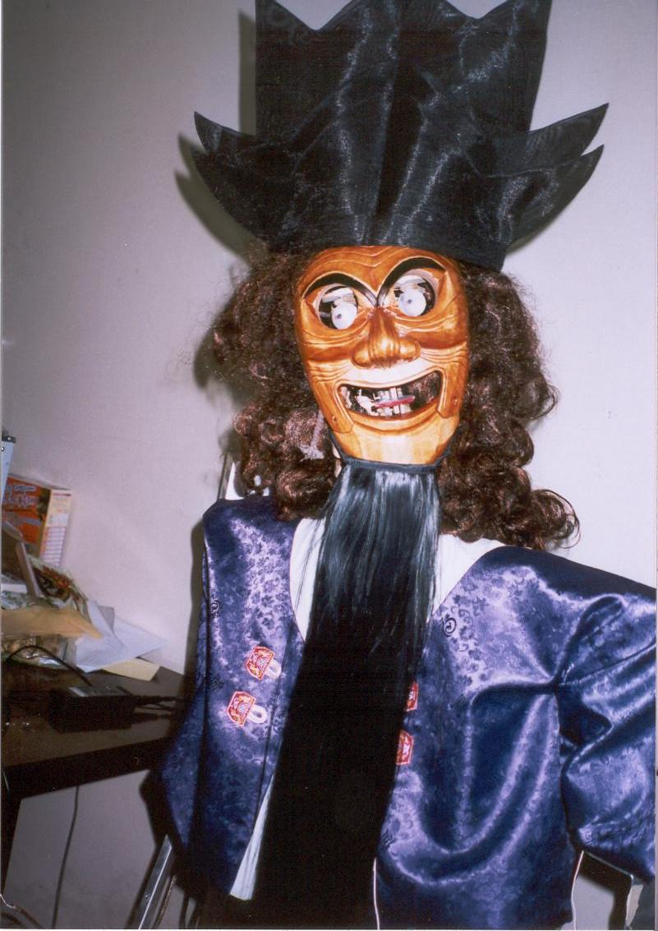
Sonbi – the Confucian Scholar

Slide 9
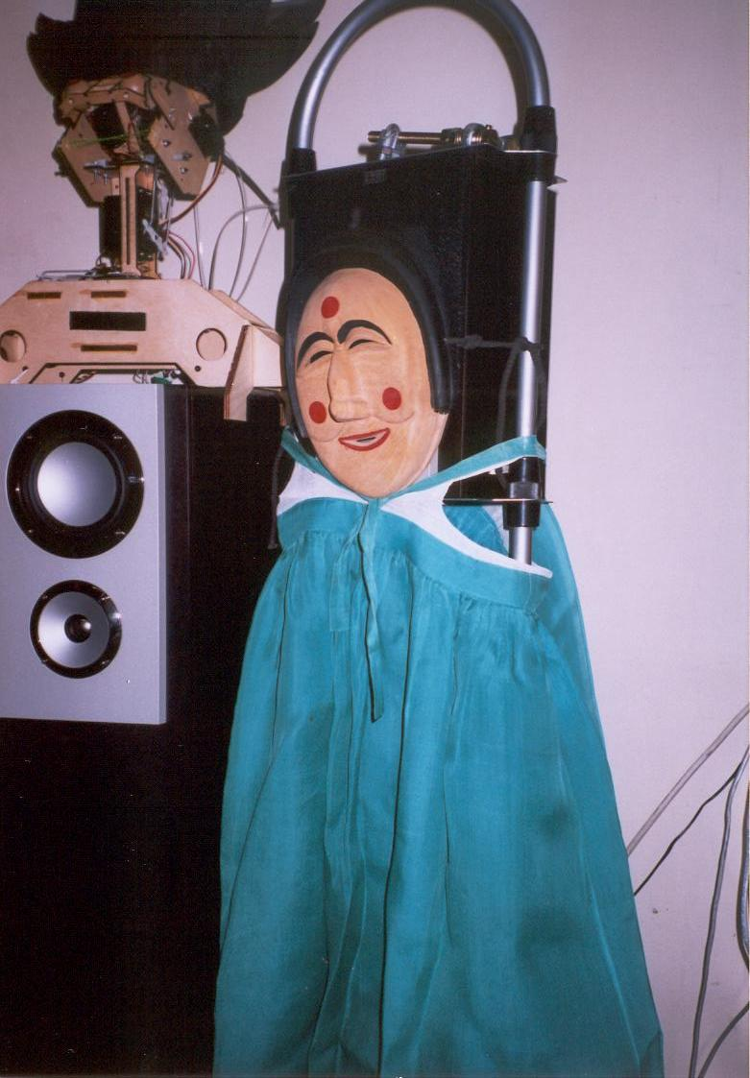
Yangban an aristocrate and Pune, his concubine

Slide 10
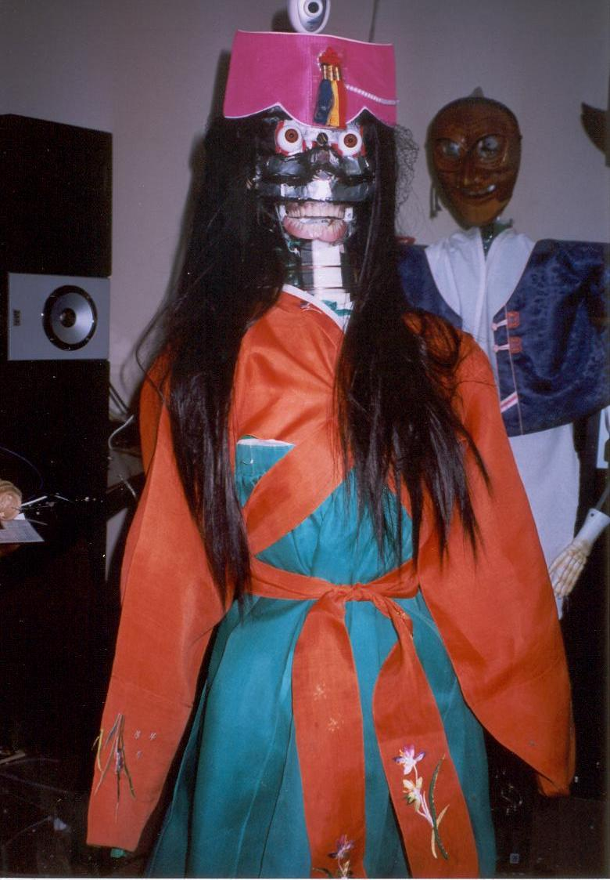
The interpreter robot without face skin

Slide 11
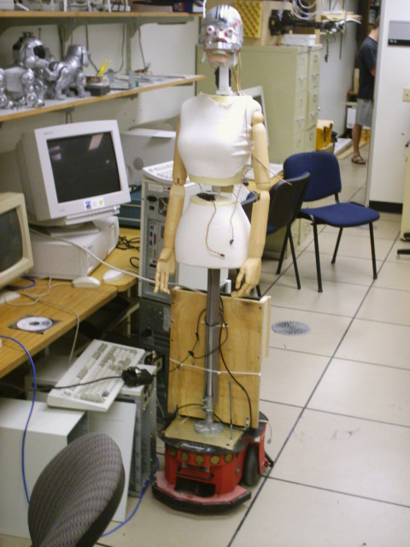
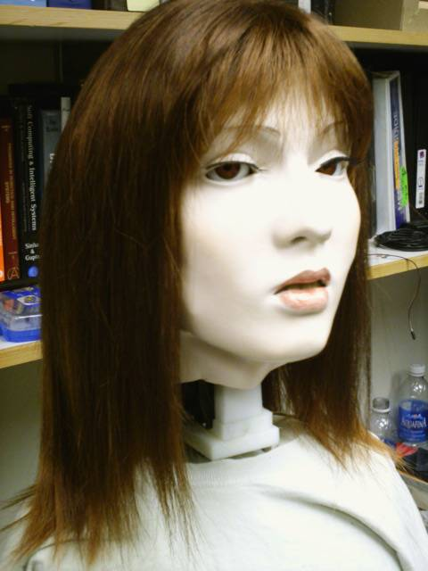
The same robot 2005, June

Slide 12
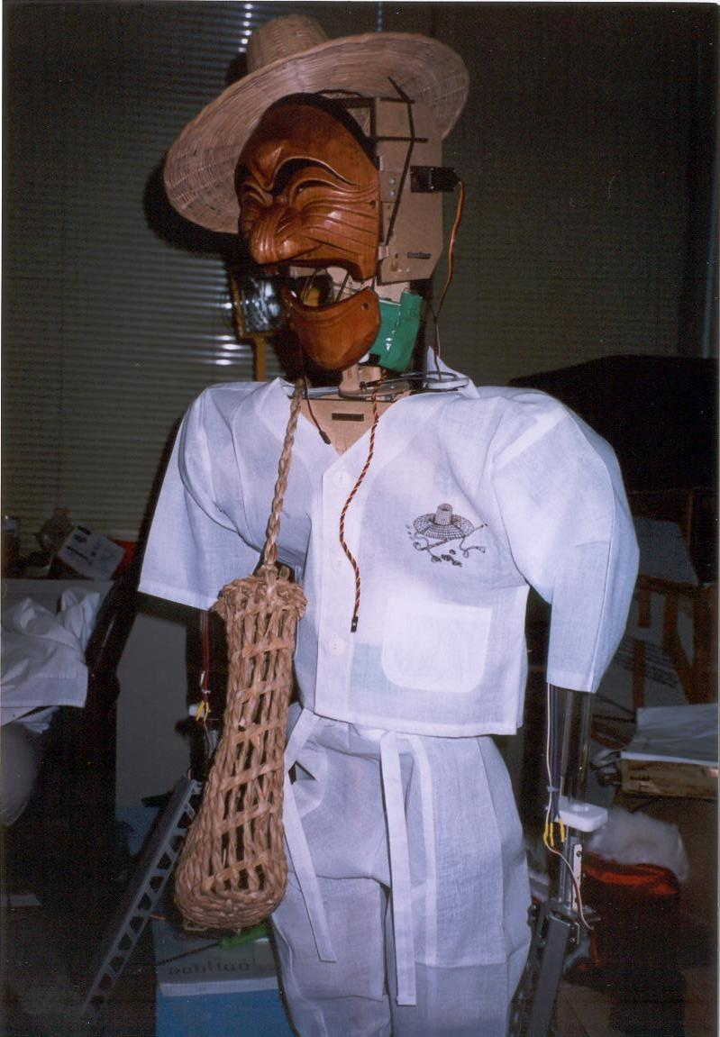
Paekchong, a bad butcher

Slide 13
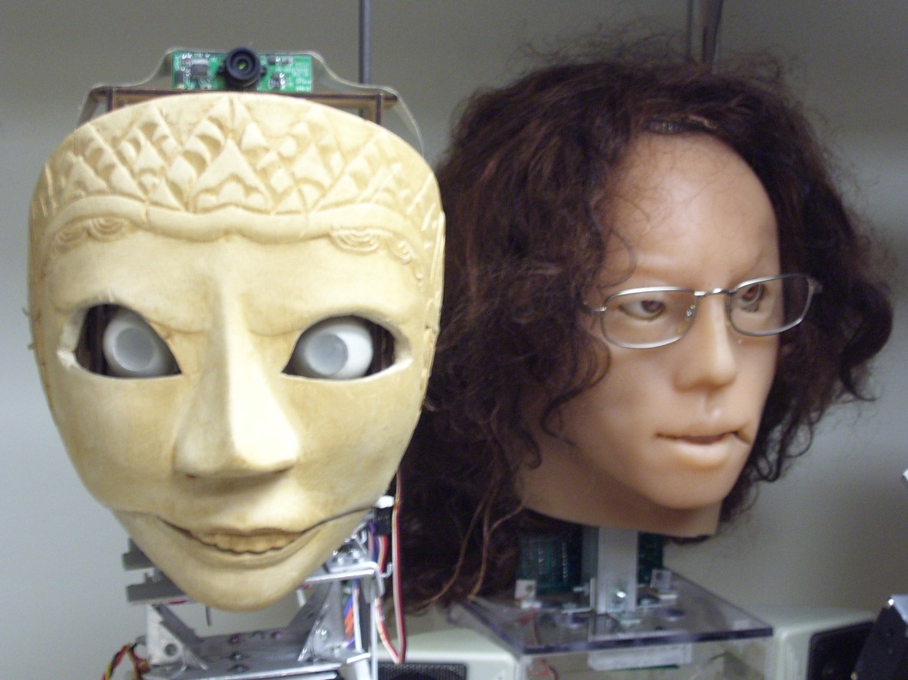
Lion one

Slide 14
Quantum Consciousness Play, Act 1
Laboratory of Marie Curie-Skłodowska at Sorbonne

Slide 15
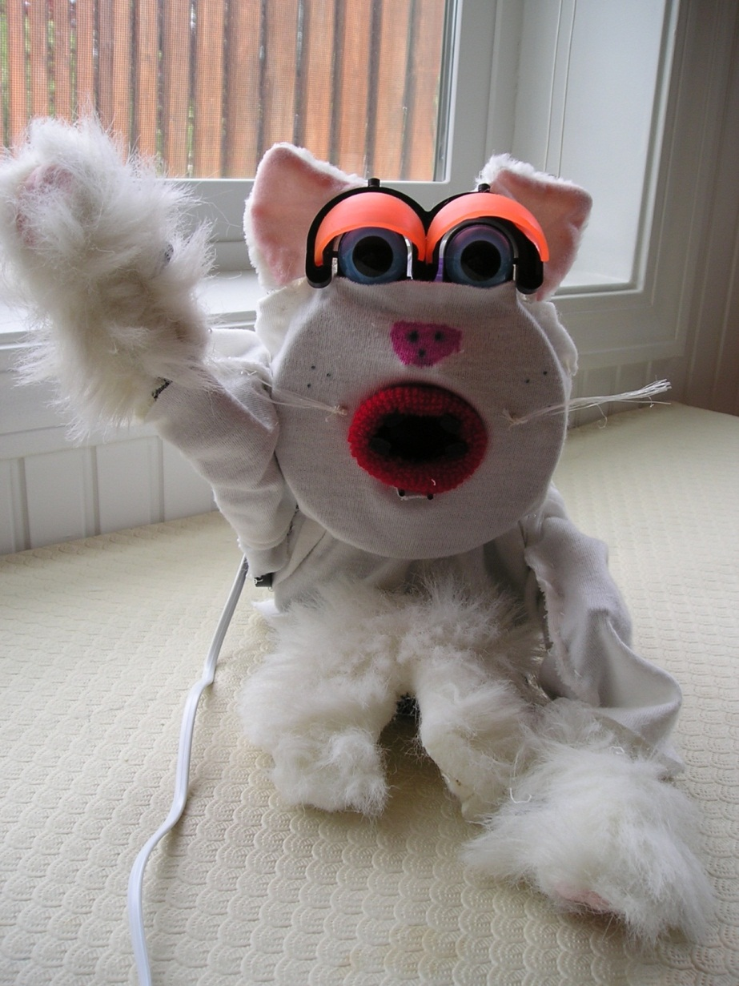
Schrödinger Cat

Slide 16
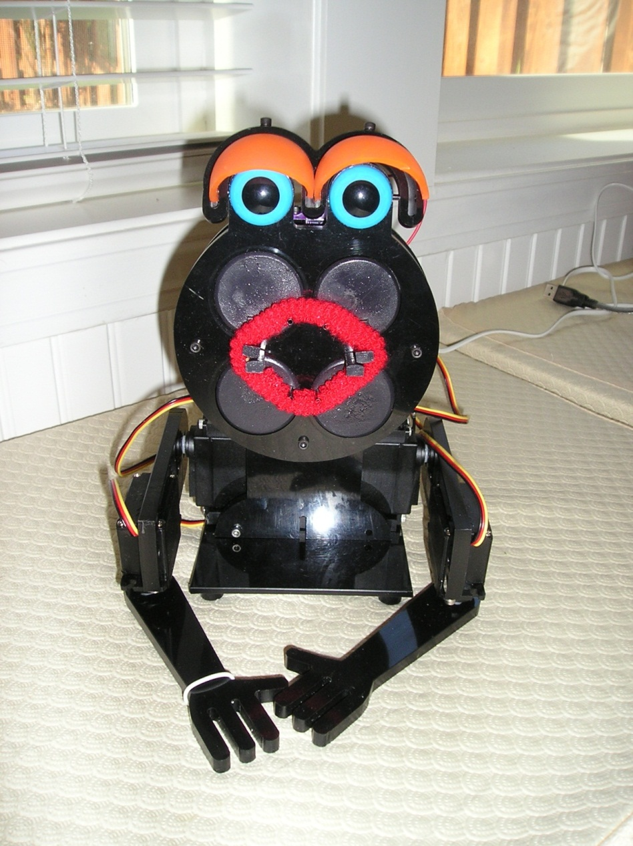
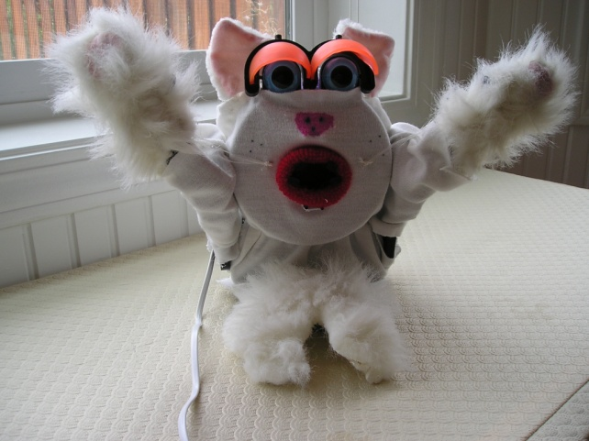
Evolution of Schroedinger Cat

Slide 17
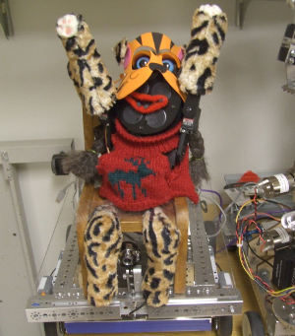

Slide 18
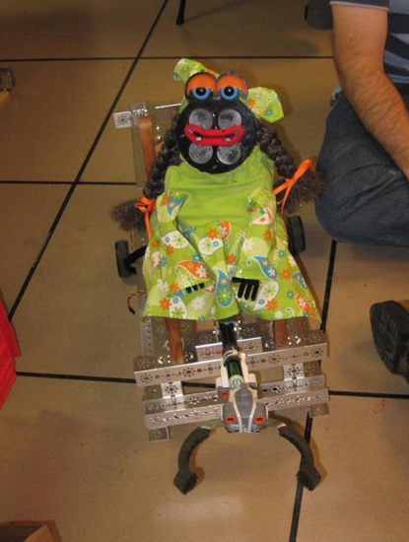

Slide 19
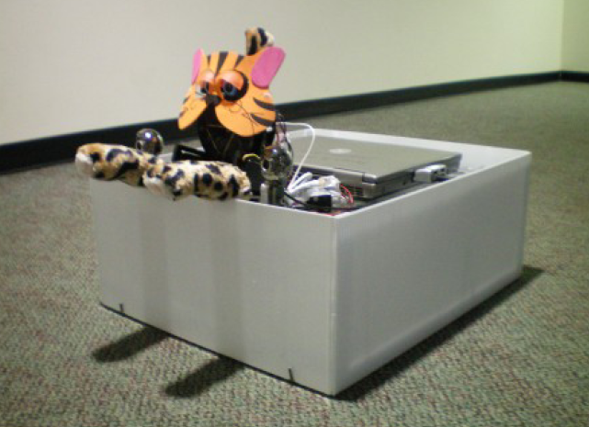

Slide 20
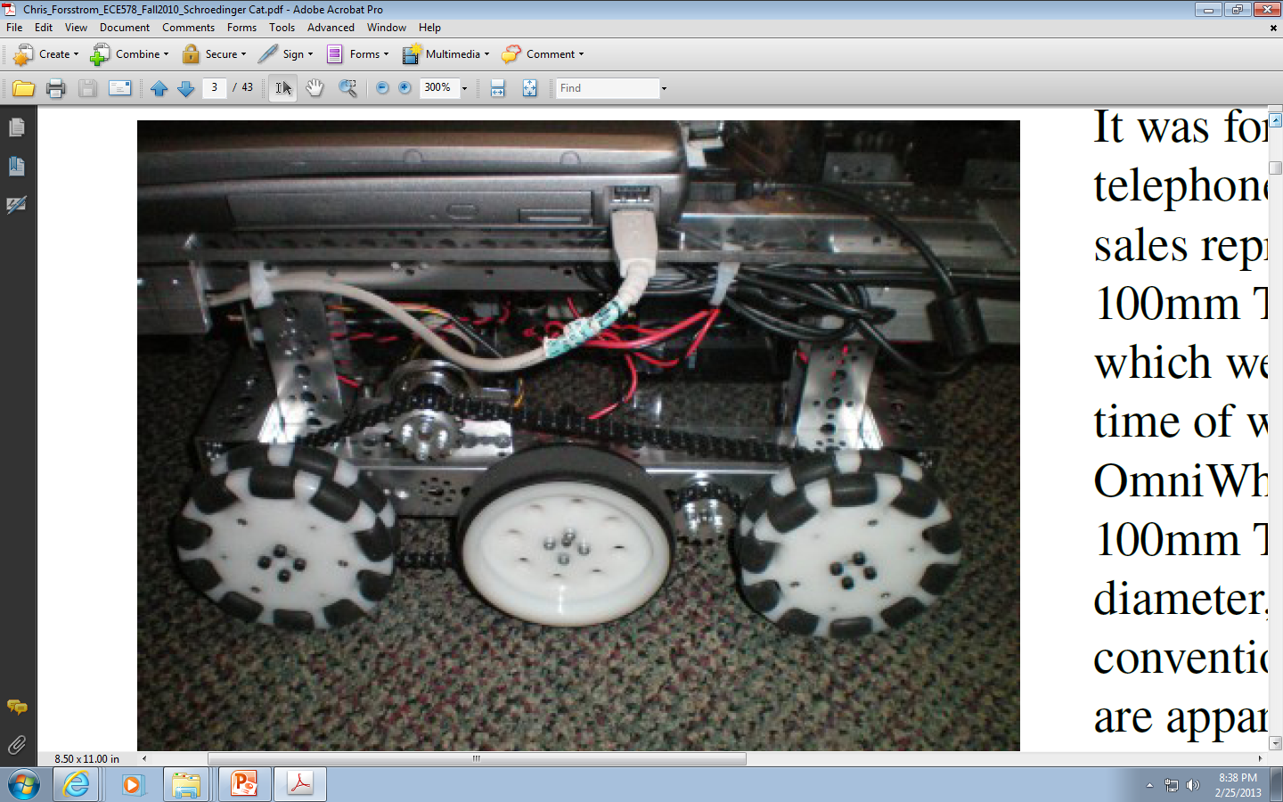

Slide 21
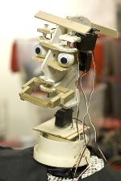
Sir Isaac Newton
First head

Slide 22
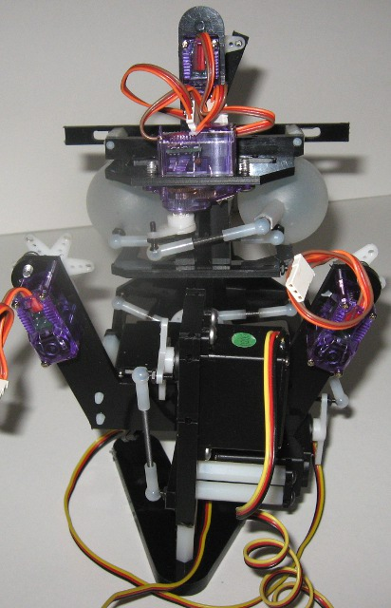
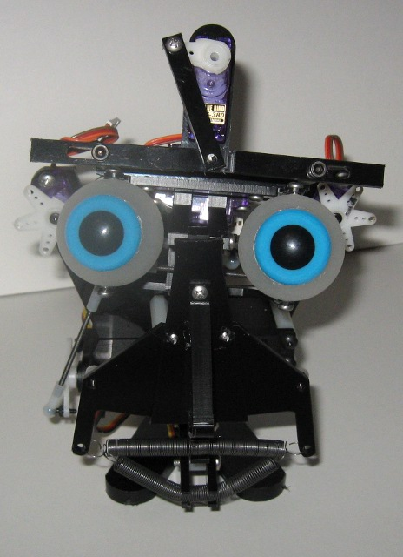
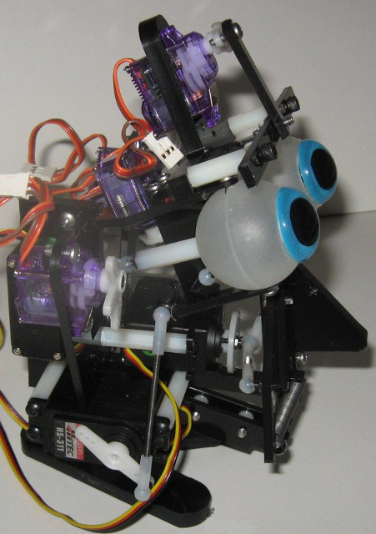
Second Head

Slide 23
Young
Isaac Newton
Third head

Slide 24
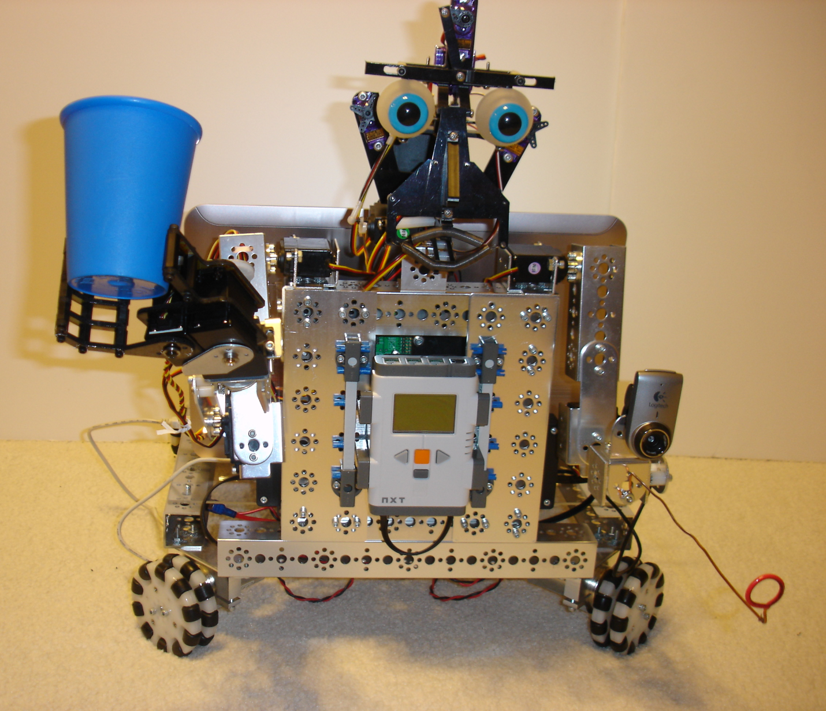
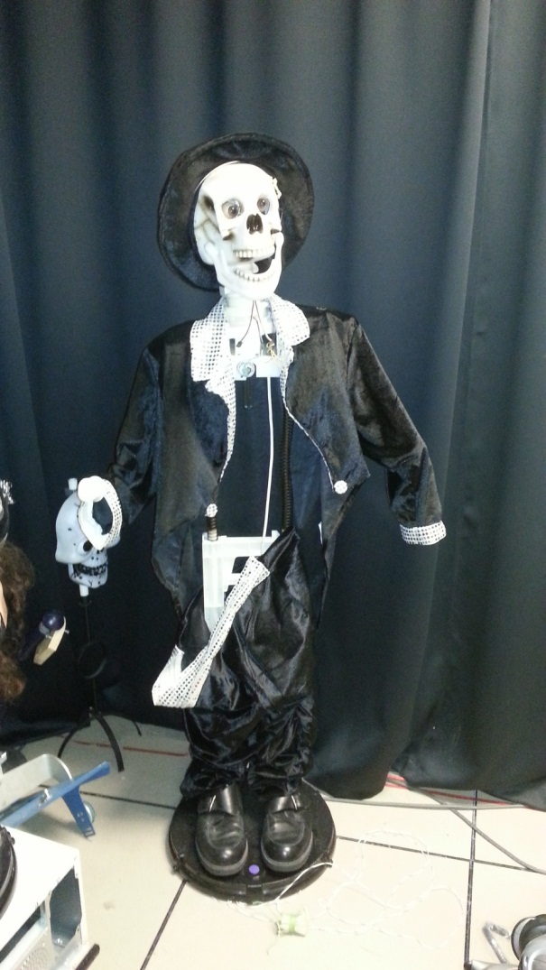
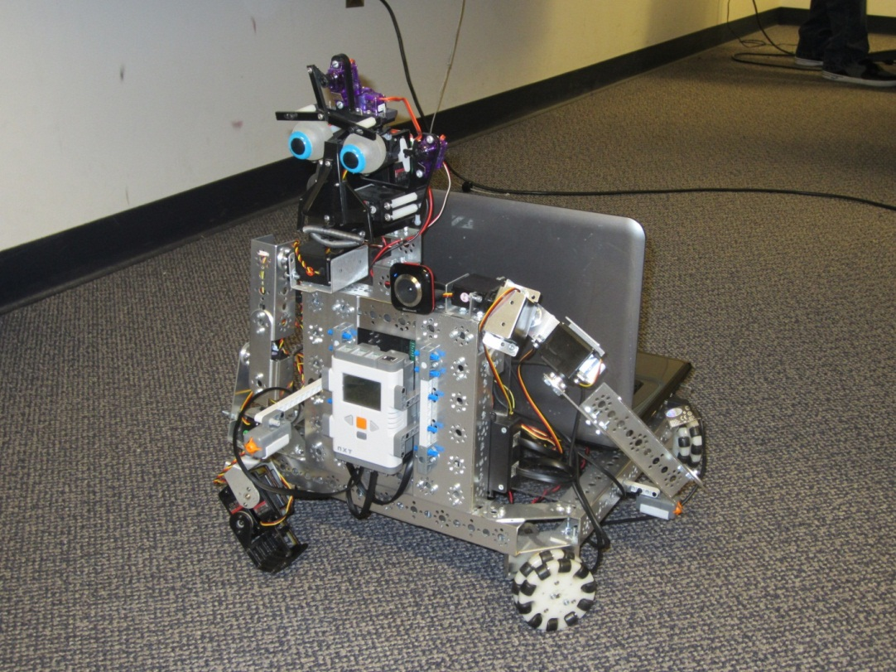
Newton’s ever changing body

Slide 25
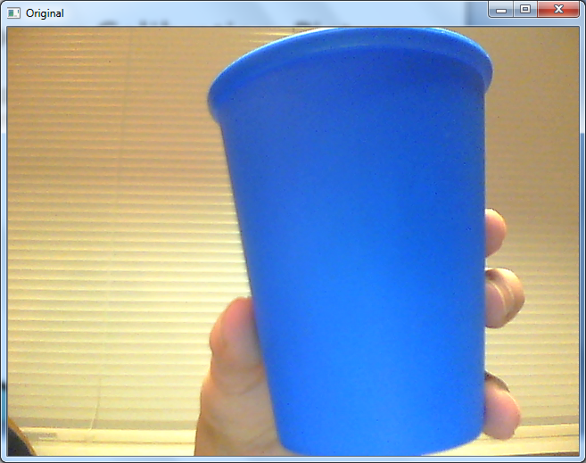
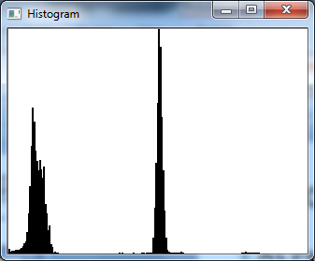
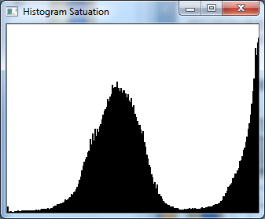
Vision System: Histograms
With a clean background, the two peaks of the hue (above right) and saturation (bottom left) histograms can clearly be seen

Slide 26
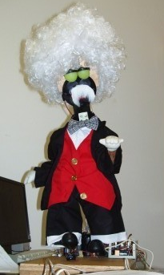
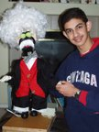
Professor Albert Einstein

Slide 27
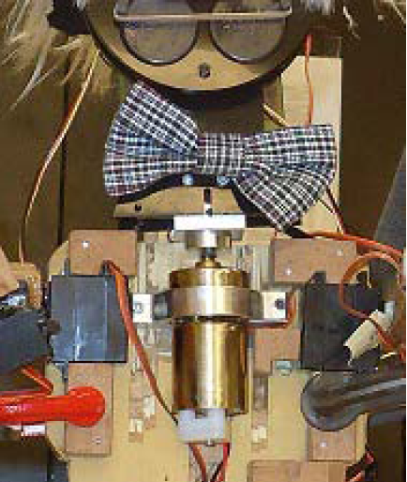

Slide 28
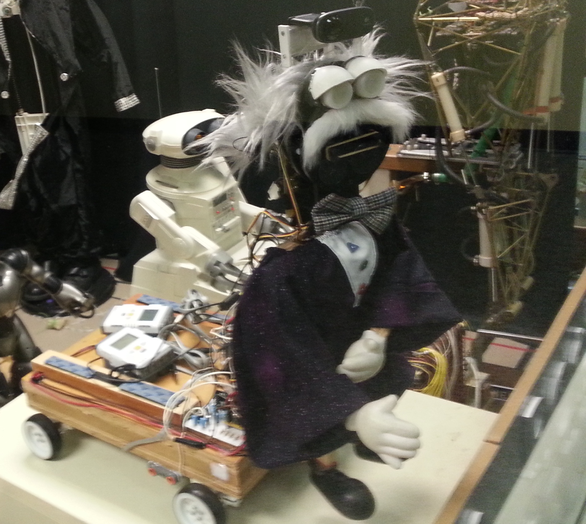

Slide 29
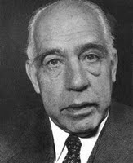
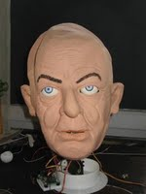
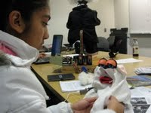
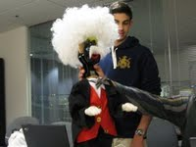
Physics Debate Theatre of medium robots
Dr. Niels Bohr
Schroedinger Cat
Professor Albert Einstein

Slide 30
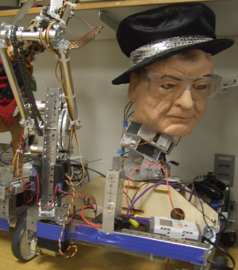
Niels Bohr

Slide 31
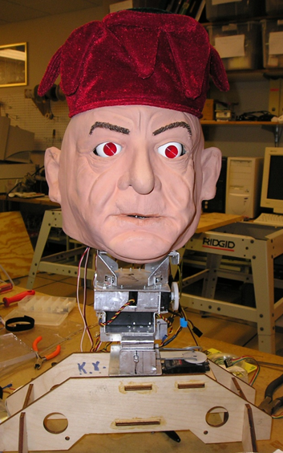

Slide 32
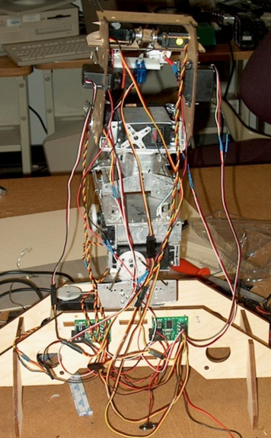

Slide 33
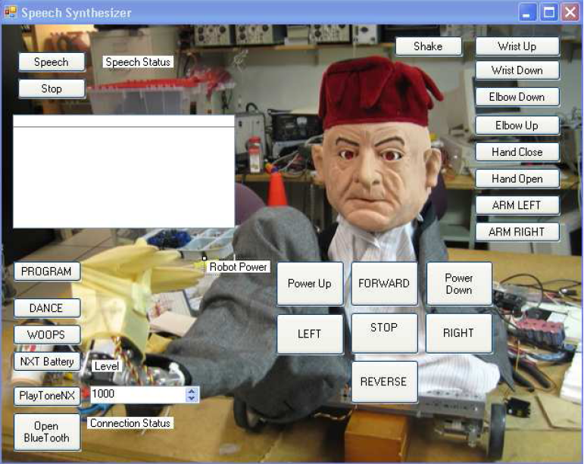

Slide 34
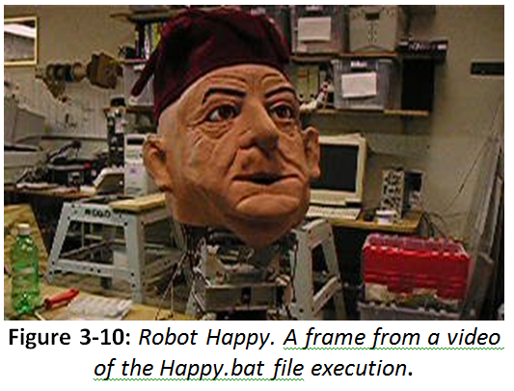

Slide 35
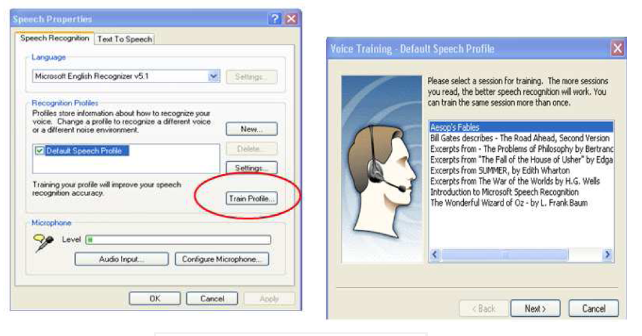
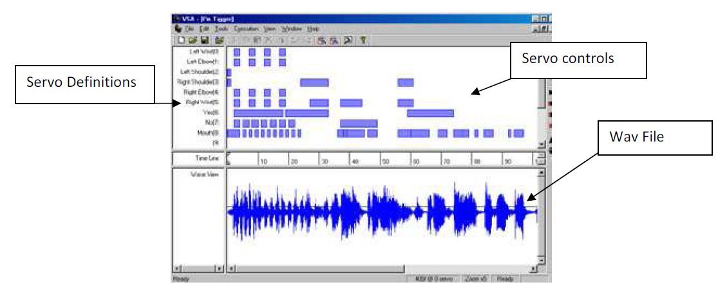

Slide 36
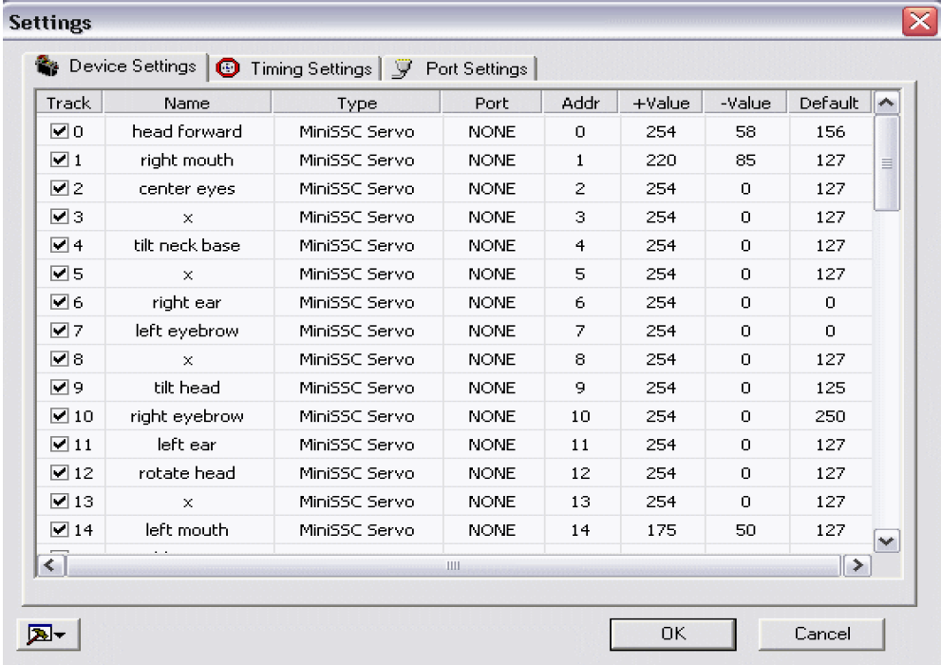

Slide 37
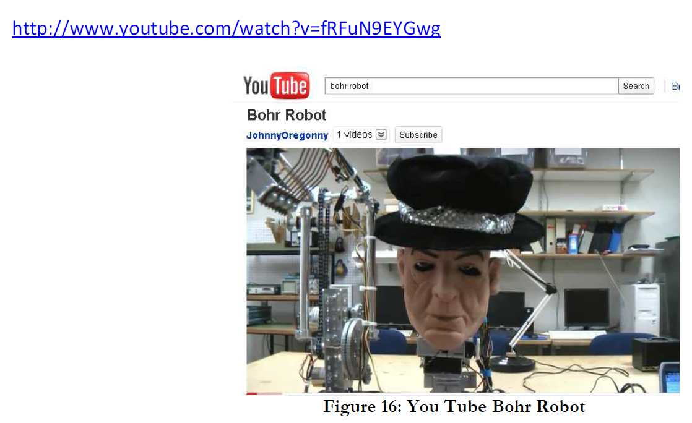

Slide 38
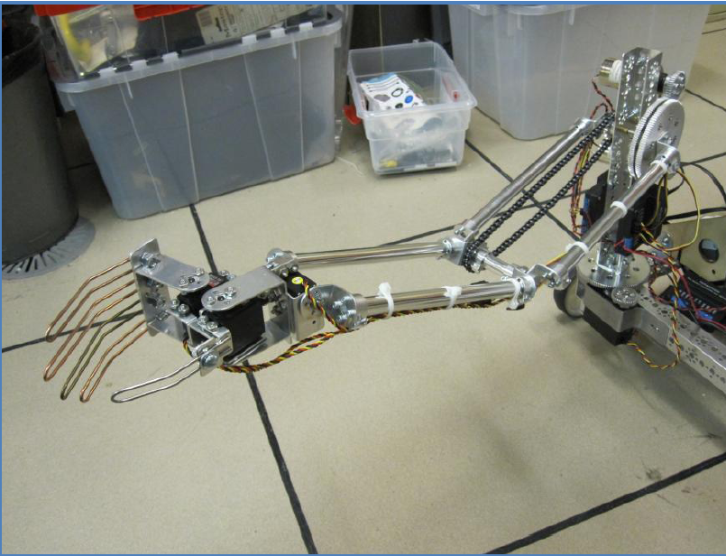

Slide 39
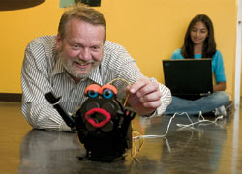
Behavior Generation and Verification
Human evaluators
Interactive Genetic Algorithm
Behavior expression
robot
Probabilistic Automaton behavior Generator and verifier
Behavior Automaton

Slide 40
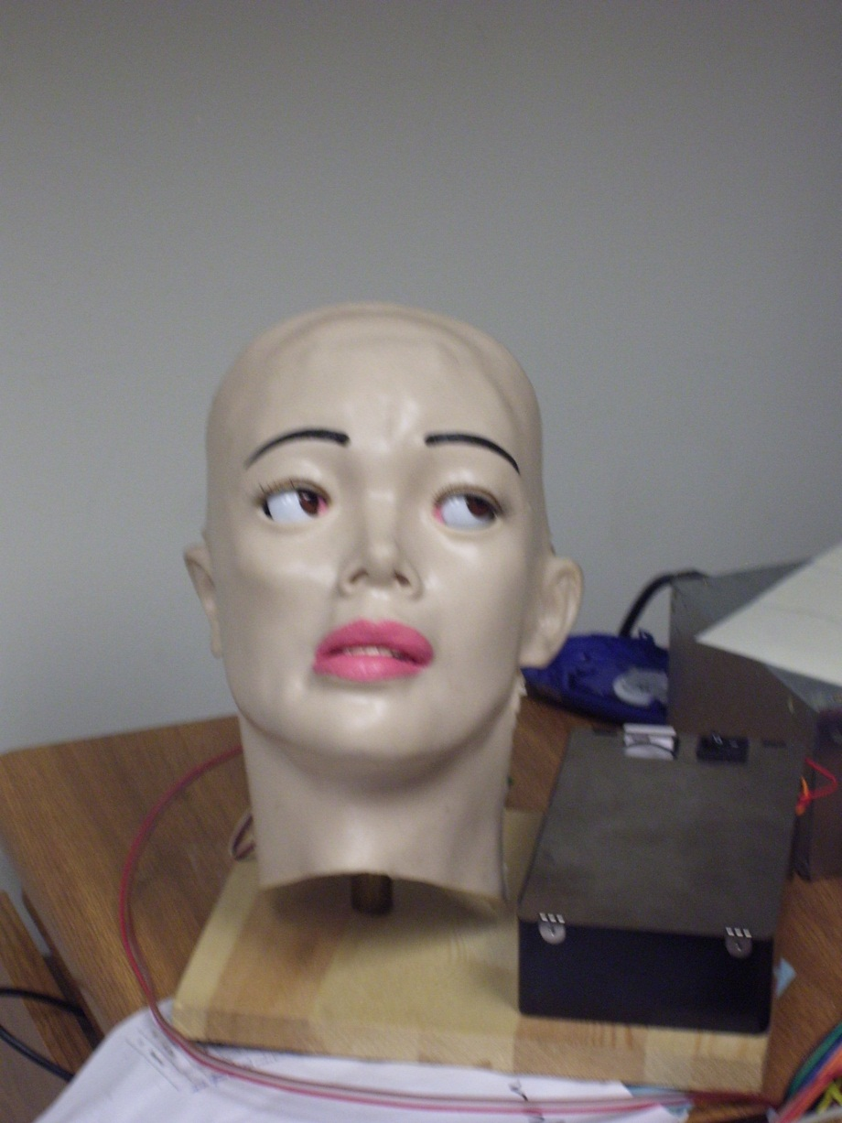
Maria Curie-Sklodowska

Slide 41
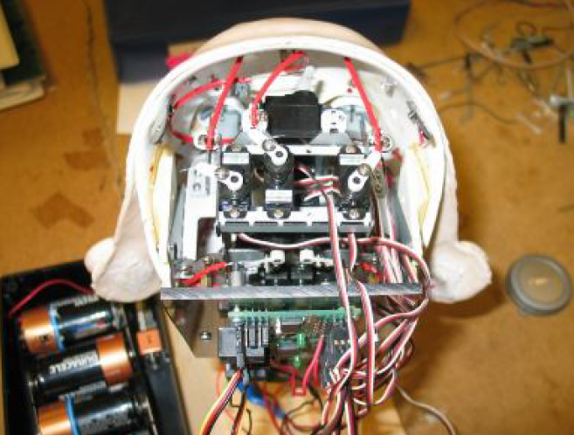

Slide 42
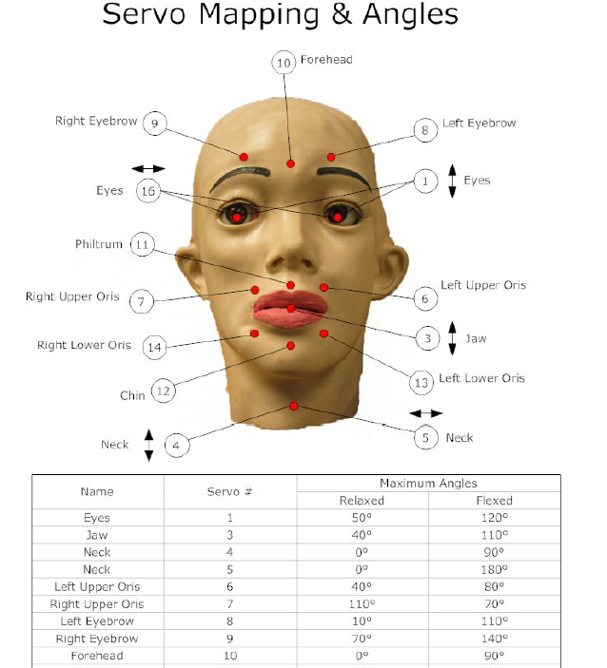

Slide 43

Hello, Professor Einstein

Slide 44

It is sunny today

Slide 45

Bad Cat, Bad Cat!
To Schrödinger cat:

Slide 46


Slide 47


Slide 48

Professor Bohr?
Who says this?

Slide 49

Or Sir Issac?

Slide 50

I am so tired

Slide 51


Slide 52

To clean the lab again

Slide 53

Oh, no!

Slide 54

Hair, make-up and hat make a woman!

Slide 55

surprise

Slide 56

happiness

Slide 57

love

Slide 58

Einstein, Oh!

Slide 59


Slide 60
Theatre of small robots
Inside the Atom, dancing with Electrons

Slide 61

KHR-1
iSOBOT
Lynxmotion Systems

Slide 62

Walking biped robot can express the fullness of human emotions:
  body gestures,
  dancing,
  jumping,
  gesticulating with hands.
Emotions can be:
  Emergent - Arushi
  Programmed – Martin Lukac ISMVL
  Mimicked – ULSI
  Learned – Martin Lukac Reed-Muller
Fighting KHR-1 robots

Slide 63


iSOBOT

Slide 64


Slide 65

Dancing Hexapod

Slide 66


Slide 67
Fourth Act of Quantum Consciousness Play
Graduation at PSU

Slide 68


..and meet all our robots

Slide 69

Quantum Robot

Slide 70


